Slide 1

Cryptography
CS-486
November 6th, 2017 r00 Paul A. Lambert

Slide 2
Cryptography Monday November 6th, 2017
Homework discussion ECIES:
http://web.cs.ucdavis.edu/~rogaway/papers/moral-fn.pdf
Due Wednesday November 8th
Estonia again, recent problems with implementations of RSA:
https://www.ria.ee/public/RIA/Cryptographic_Algorithms_Lifecycle_Report_2016_2.0_A-101-3.pdf
https://acmccs.github.io/papers/p1631-nemecA.pdf
https://github.com/crocs-muni/roca
http://perso.telecom-paristech.fr/~guilley/recherche/cryptoprocesseurs/ieee/00891000.pdf
Wireshark
Quiz: Wireshark capture of TLS exchange
SSL and TLS
Wireshark, filtering for ssl
https://idea.popcount.org/2012-06-17-ssl-fingerprinting-for-p0f/
https://www.owasp.org/images/4/4c/Practical_Invalid_Curve_Attacks_on_TLS-ECDH_-_Juraj_Somorovsky.pdf
https://www.esat.kuleuven.be/cosic/publications/article-1432.pdf
RWC
https://rwc.iacr.org/2016/program.html
https://rwc.iacr.org/2017/program.html

Slide 3
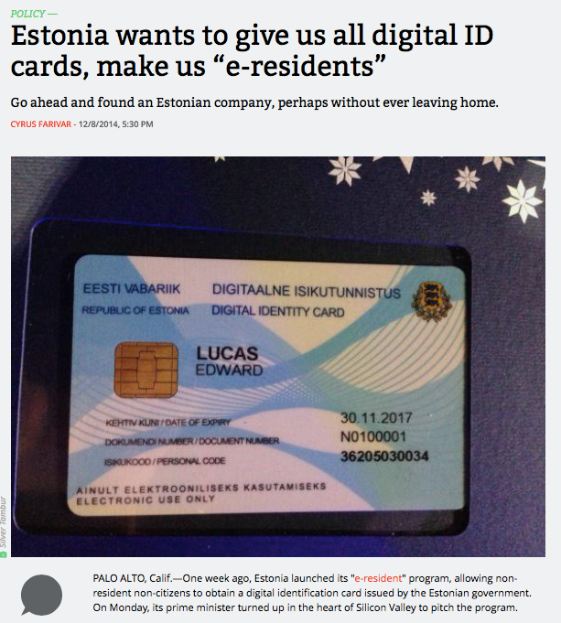
2014
description in IACR
https://www.ria.ee/public/RIA/Cryptographic_Algorithms_Lifecycle_Report_2016_2.0_A-101-3.pdf
Aris Technica 12/8/2014

Slide 4
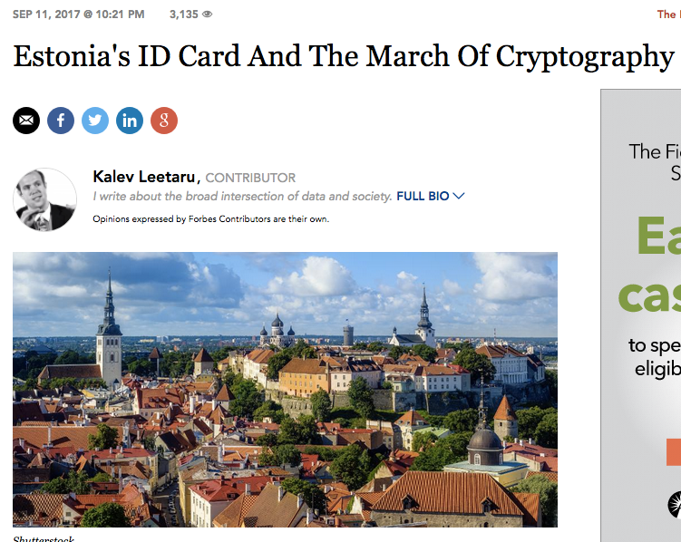
2017
Reported flaws:
http://news.err.ee/108556/the-flaw-in-the-estonian-id-card
Aris Technica 12/8/2014

Slide 5
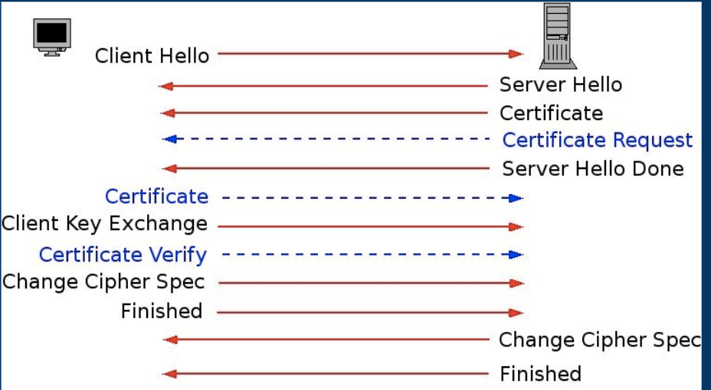
TLS
https://www.phildev.net/ssl/ssl_talk_uuasc.pdf

Slide 6
ECIES
Use public/private key pairs to encrypt information to public key(s). Use ECIES to encrypt the information. For example, Figure 2 in: A Survey of the Elliptic Curve Integrated Encryption Scheme
Elliptic curve routines are available: https://github.com/CryptoUSF/Wallet/tree/master/src/ecc
AEAD encryption algorithms are available on Github:
AES-SIV https://github.com/CryptoUSF/Wallet/tree/master/src/cipher
ChaCha_Poly_AEAD https://github.com/CryptoUSF/Wallet/blob/master/src/cipher/chacha_poly.py
Document your choices for each algorithm block (e.g. KDF). The ECIES routines should be structured as a reusable library. The user interaction may be through a command-line interface. The software should be in a github repository with a readme.md file providing a brief description.
Bonus points awarded for:
documentation of requirements or use case
good documentation
fully 'packaged' software
well written code
designs with good human usability

Slide 7
TLS Packet Capture
Install and run ‘wireshark’
May require ‘sudo’
Set filter for ‘ssl’
Open browser and connect to a HTTPS web page
Examine packets captured for TLS packet exchange
Identify cipher suites from client
Identify server certificates
Identify algorithms used by server

Slide 8
Backup Material

Slide 9
Logistics for Class
Canvas CS-486-01
Primary repository for grading
URL for all homework submittals must be ‘linked’ into the appropriate Canvas assignment!
Github: https://github.com/CryptoUSF
Course material, class presentations, references, books
Sample code for assignments: https://github.com/CryptoUSF
Private student repositories,
too many if one per assignment per student
Wiki for additional class information and assignements
Piazza: CS486
Informal class conversations

Slide 10
Additional References
Courses:
https://crypto.stanford.edu/~dabo/courses/OnlineCrypto/
http://cseweb.ucsd.edu/~mihir/cse207/
Conferences:
Real World Cryptography
https://www.iacr.org
Mailing Lists and Standards:
http://csrc.nist.gov US Federal security specifications
https://trac.ietf.org/trac/sec/wiki Internet security standards
https://irtf.org/cfrg Internet cryptographic research

Slide 11
Raspberry Pi
We will use a Raspberry Pi to get experience using contemporary analysis ‘tools’
Raspberry Pi
Excellent reference for what to acquire and how to setup:http://rpi.cs.usfca.edu/2017-fall
The first Pi project will use cryptographic related tools that are available in the Kali distribution: https://www.kali.org/
The tools do not necessarily require the Kali OS distribution and you may be able to simply install some of the tools on an existing Raspberry Pi OS installation.

